Slide 1
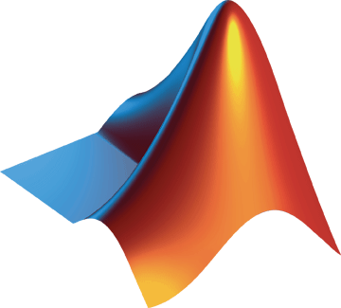
Low Code Data Analysis with MATLAB
APU

Slide 2
Agenda
Low Code Data Analysis
Demo – Modeling Flight Sensor Data
Learning Resources

Slide 3

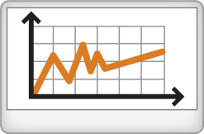




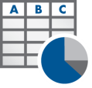


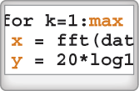


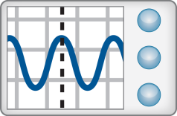
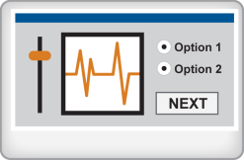
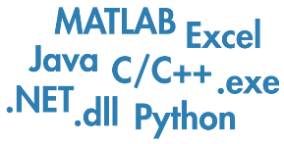
MATLAB simplifies the data analysis workflow with low code tools
Access
Explore & Discover
Share
Files
Reporting and Documentation
Data Analysis & Modeling
Software
Algorithm Development
Outputs for Design
Code & Applications
Application Development
Hardware
Deployment
Automate

Slide 4
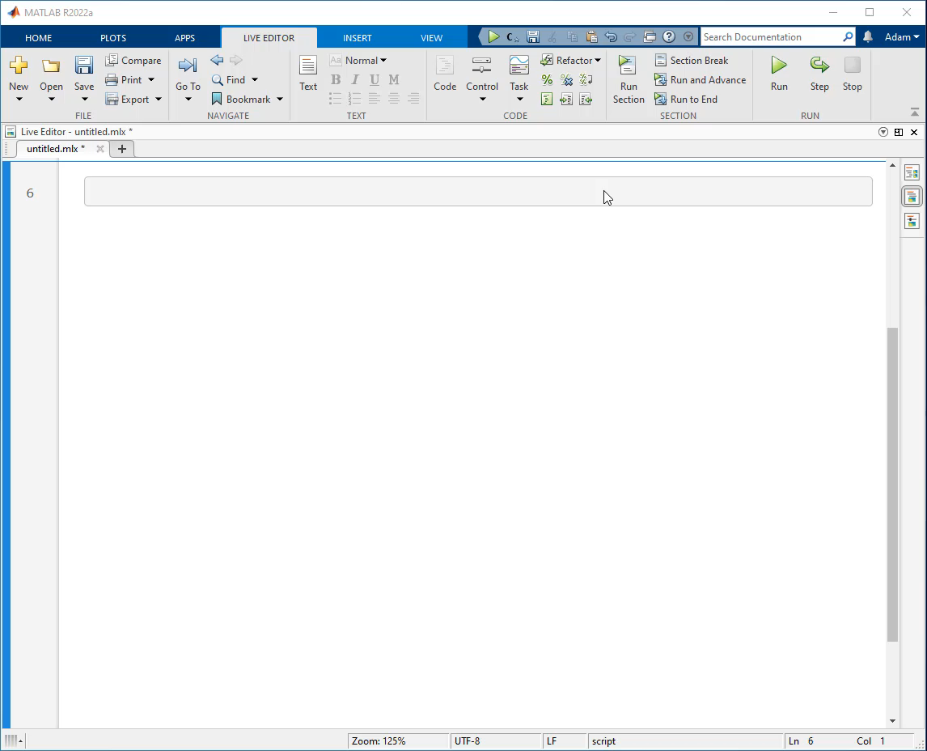
What are “low code” tools?
Low code tools enable:
rapid software development
minimal manual coding
Benefits of low code tools:
Shallow learning curve
Teach how to code
Solve task first, code later
Not just for beginners
Notes:
MATLAB accomplishes low code by automatically generating reusable code from interactive tools.

Slide 5
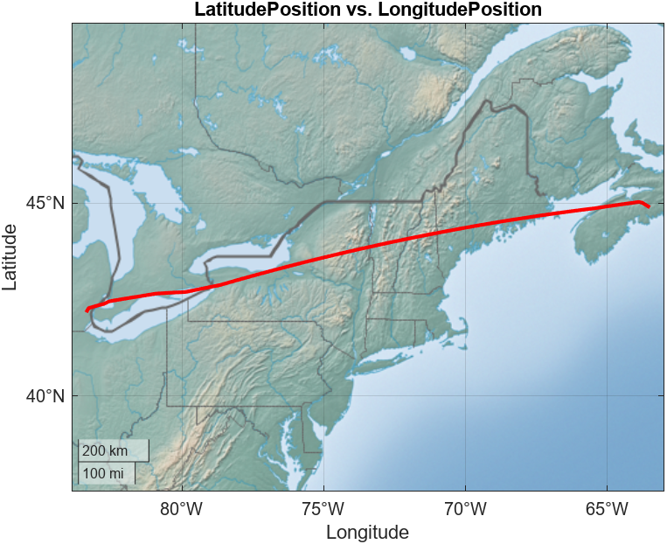
Case Study: Modeling Flight Sensor Data
Objective:
Create a virtual sensor model for non-observable or costly-to-observe states
Inputs:
Excel file with 13 sensors from 1 flight
Approach:
Visualize and explore data
Clean sensor anomalies
Train regression model to predict state
Share results in a report
Source:
NASA Dash Link: Sample Flight Data

Slide 6

MATLAB simplifies the data analysis workflow with low code tools
Products Used
MATLAB
Statistics and Machine Learning Toolbox
Access
Explore & Discover
Share
Files
Reporting and Documentation
Data Analysis & Modeling
Software
Algorithm Development
Outputs for Design
Code & Applications
Application Development
Hardware
Deployment
Automate

Slide 7
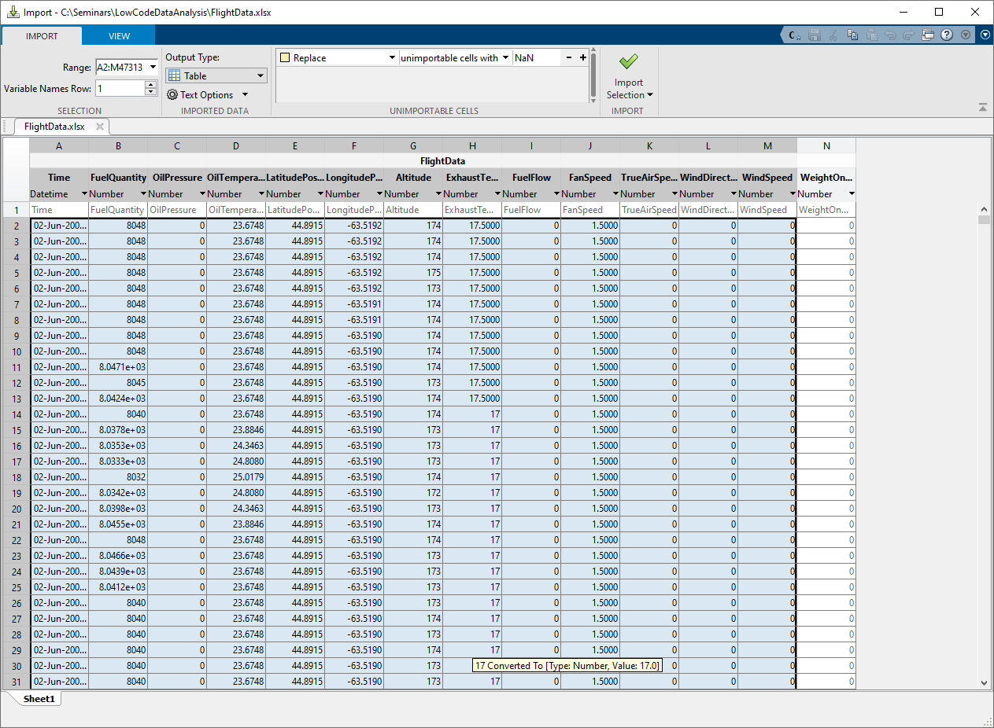
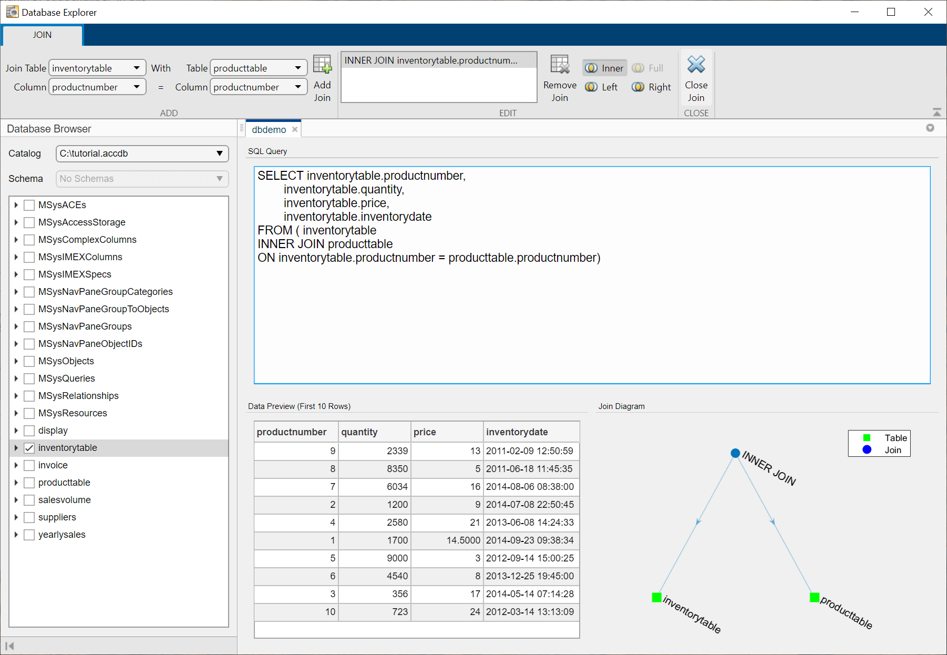
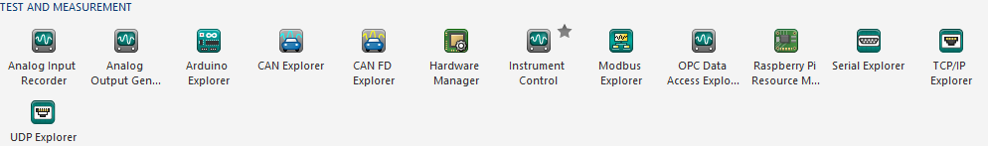
Use low code tools for easy access to files, databases, and hardware
Access
Explore & Discover
Share
Import Tool
Text, CSV, and Excel files
Database Explorer (Database Toolbox)
ODBC & JDBC SQL Databases
Measurement hardware and industrial data
Data acquisition hardware (Data Acquisition Toolbox)
Stand-alone instruments and hardware (Instrument Control Toolbox)
OPC UA and Aveva PI Server, Modbus devices (Industrial Communication Toolbox)
CAN, J1939, and XCP (Vehicle Network Toolbox)

Slide 8


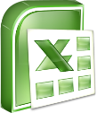
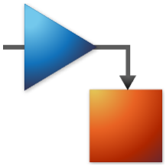

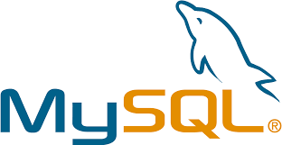

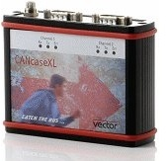



Access data in many formats from many locations
Type of data
Observational
Timeseries
Image & video
N-D
Location of data
SQL & NoSQL databases
HDFS
AWS S3
Azure Blob Storage
Simulation
Databases
Images
HDF5 Files
MDF Files
Custom
Notes:
Big data and datastores
Web APIs and RESTful
Parquet
Cloud (S3, Blob Storage)
NoSQL databases

Slide 9
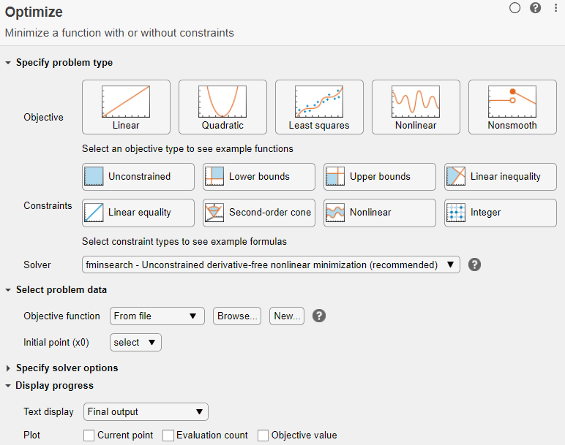
Over 100 low code tools for data analysis, engineering, and AI
Access
Explore & Discover
Share
Data Analysis
Visualize, manipulate, and preprocess
Math, statistics, and optimization

Slide 10
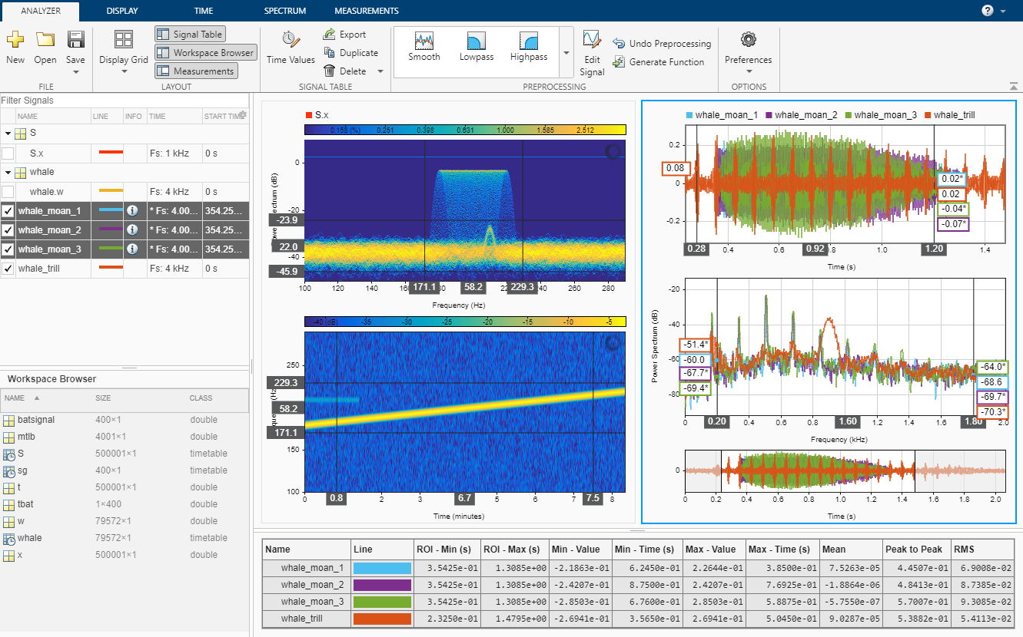
Over 100 low code tools for data analysis, engineering, and AI
Access
Explore & Discover
Share
Data Analysis
Visualize, manipulate, and preprocess
Math, statistics, and optimization
Engineering
Control system design and analysis
Signal processing and communications
Image processing and computer vision

Slide 11
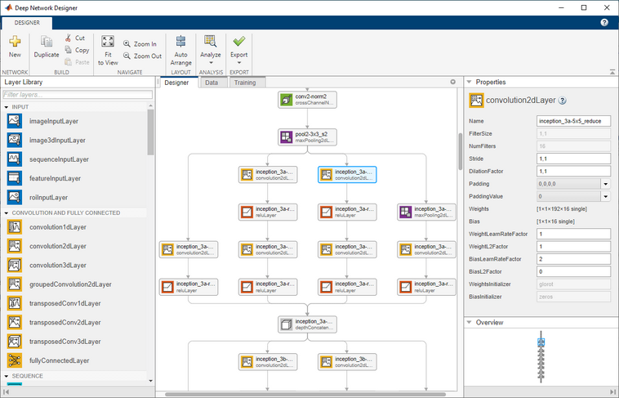
Over 100 low code tools for data analysis, engineering, and AI
Access
Explore & Discover
Share
Data Analysis
Visualize, manipulate, and preprocess
Math, statistics, and optimization
Engineering
Control system design and analysis
Signal processing and communications
Image processing and computer vision
Artificial Intelligence
Ground truth labeling
Network design, training, and validation
Quantization and deployment

Slide 12
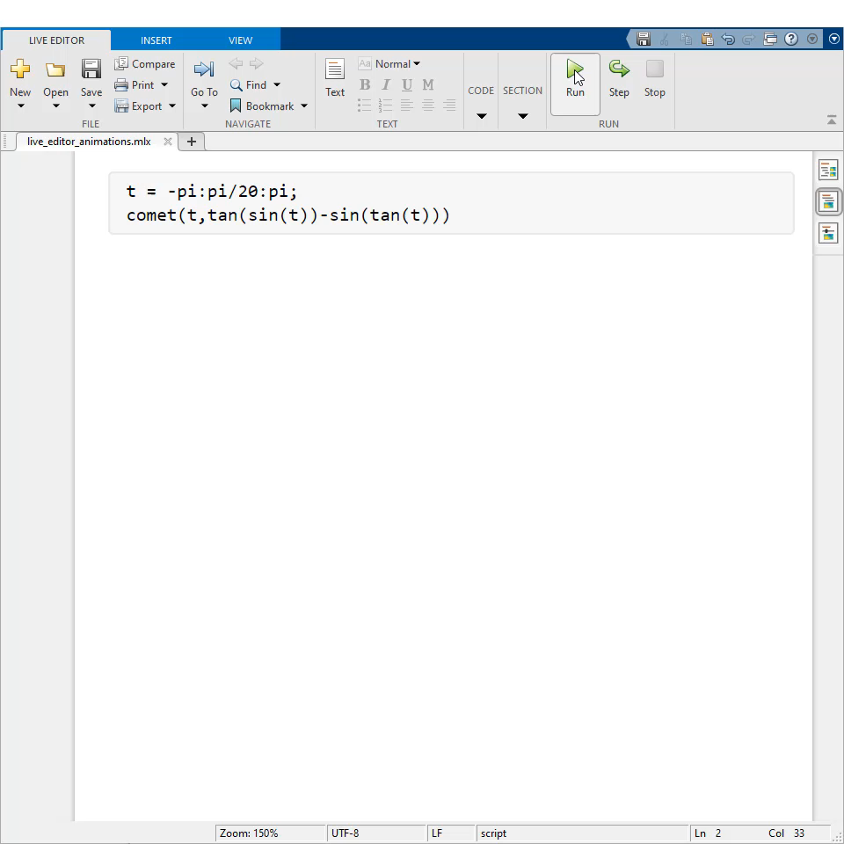
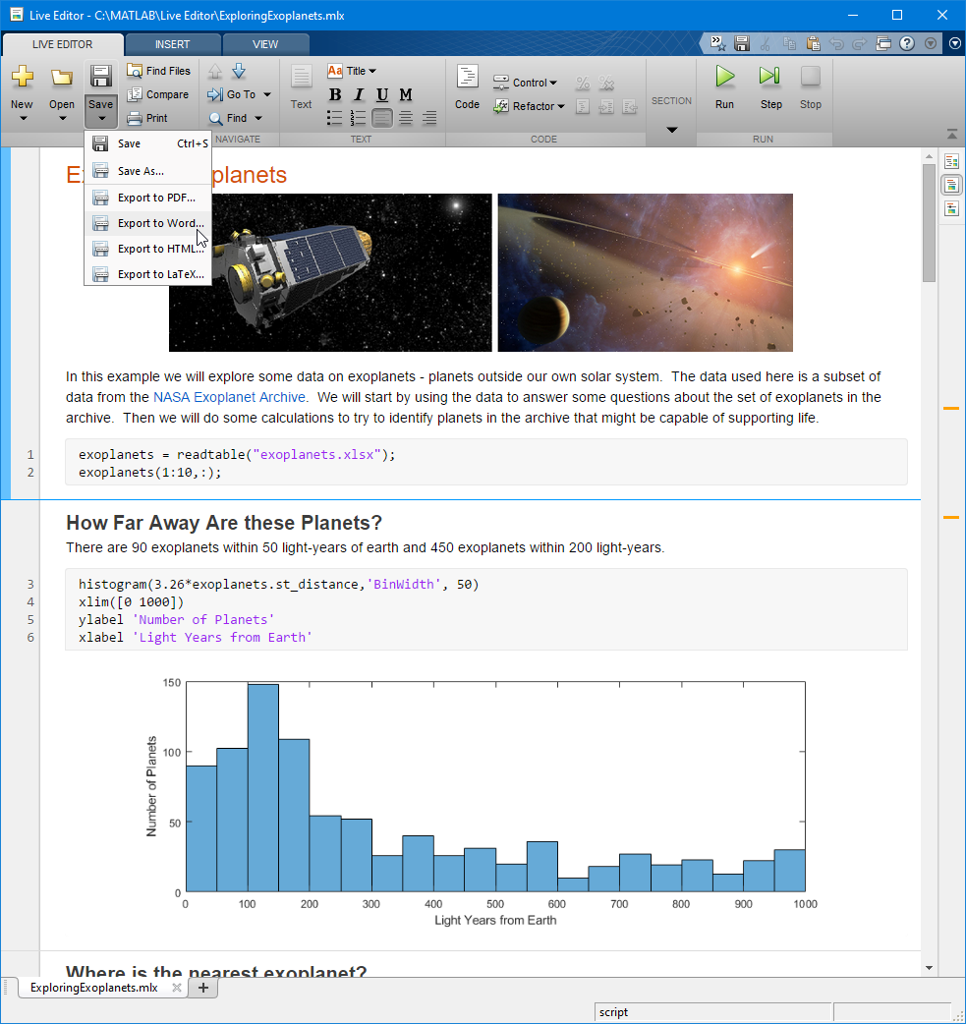
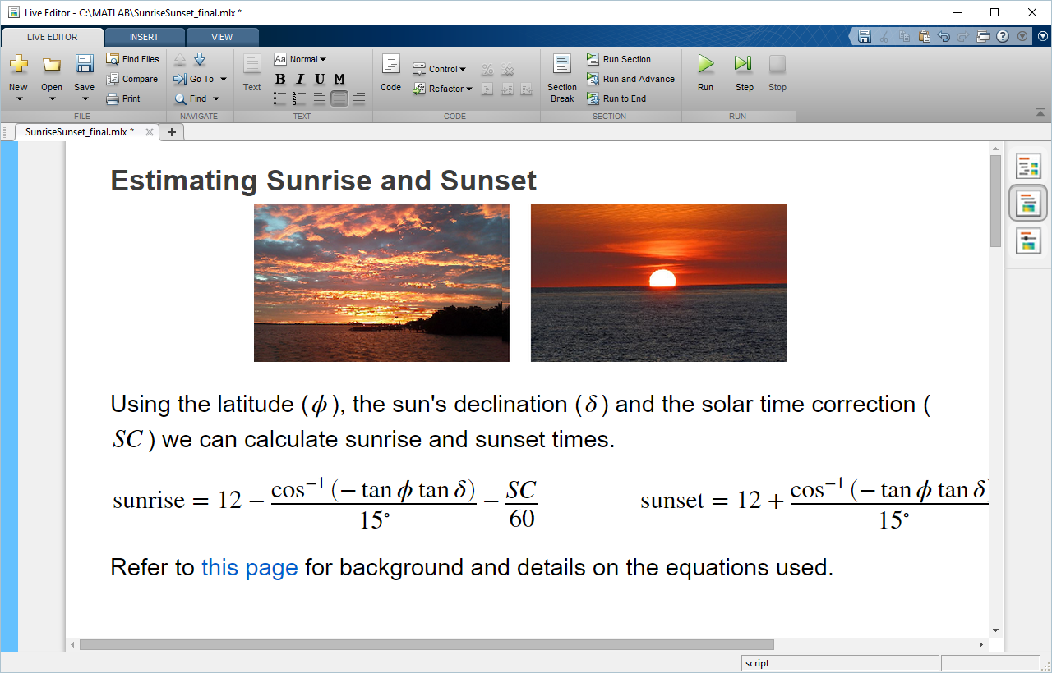
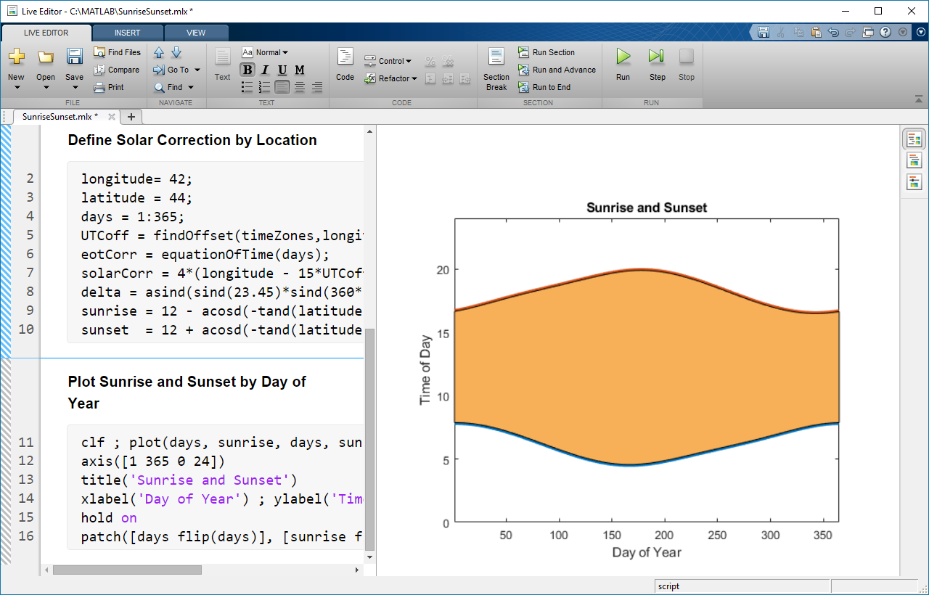
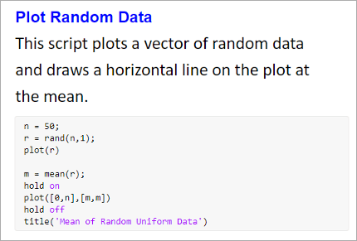
Document as you go – your script is your report
Access
Explore & Discover
Share
Divide code into sections
Embed outputs next to the code
Add rich text formatting, equations, images, and hyperlinks
Include animations with embedded controls, and export
Programmatically control fonts
Save directly to PDF, HTML, Word, and LaTeX
Notes:
Share results of MATLAB analysis
- Divide code into sections that can be executed independently, and
- View output next to the code that generated it
(click)
- Add rich text formatting, equations, images, and hyperlinks
- NOTE – in 20b, you can hyperlink to another live script. This is great for AE demonstrations, as well as for presenting and teaching use cases
(click)
Enable animations in plots
[NOTE – this required an environment variable to be set in 19a; this requirement is removed in 19b]
NOTE – in 21a, playback controls appear within the figure window after an animation is done playing. This works for animations covered on this page – except for those related to the movie function
https://www.mathworks.com/help/releases/R2021a/matlab/animation-1.html
21b adds the ability to export animations to movies or animated GIFs
(click)
Starting in 21a, you can programmatically control the name, style, size, and color of fonts using settings
(click)
- Save directly to PDF, HTML, Word, and LaTeX (click) - Here’s an example Word document generated from a live script.
- NOTE – in 20b, you can batch export all live scripts and live functions in a folder to PDF, HTML, LaTeX, or Word
(click)
This combination of code, together with the corresponding output and formatted text results in an executable notebook.

Slide 13
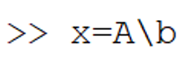
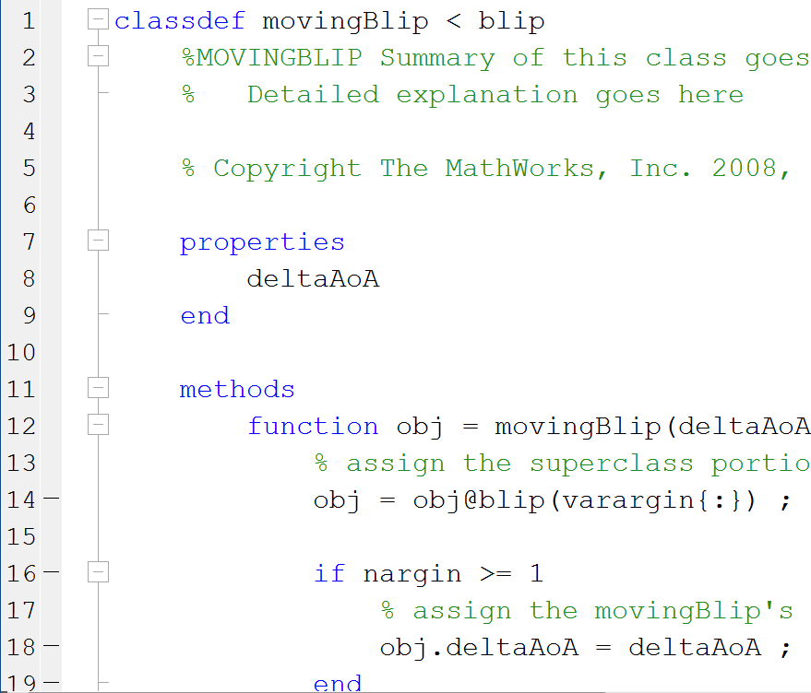
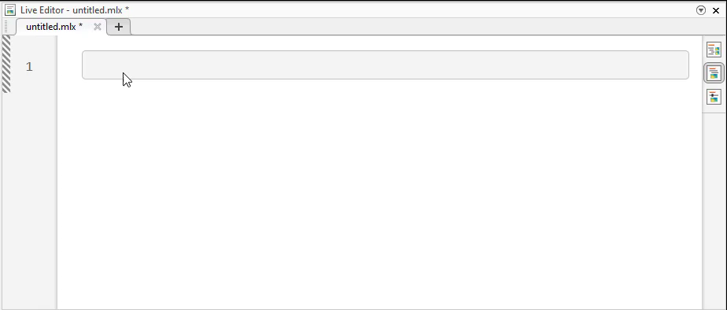
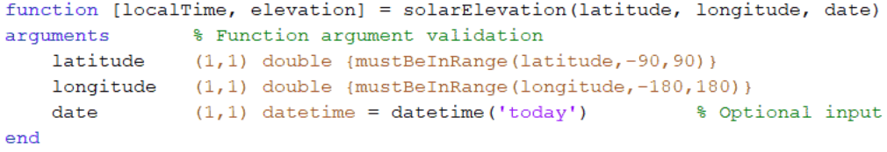
As your needs grow, the MATLAB language grows with you.
Start simple
Create scripts
Write reusable functions
Author robust applications

Slide 14
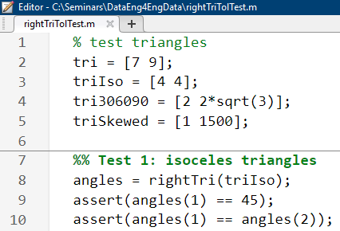
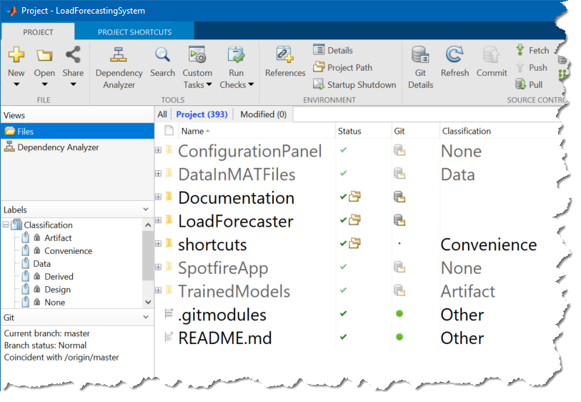
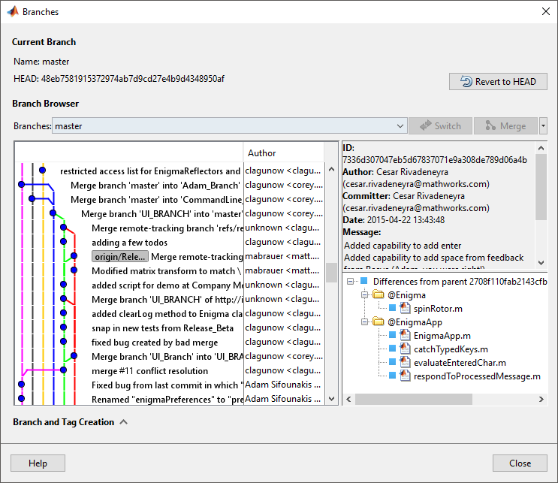
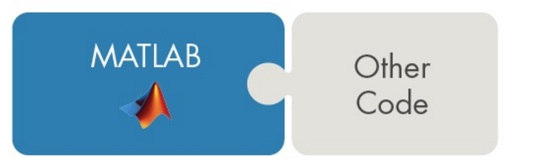
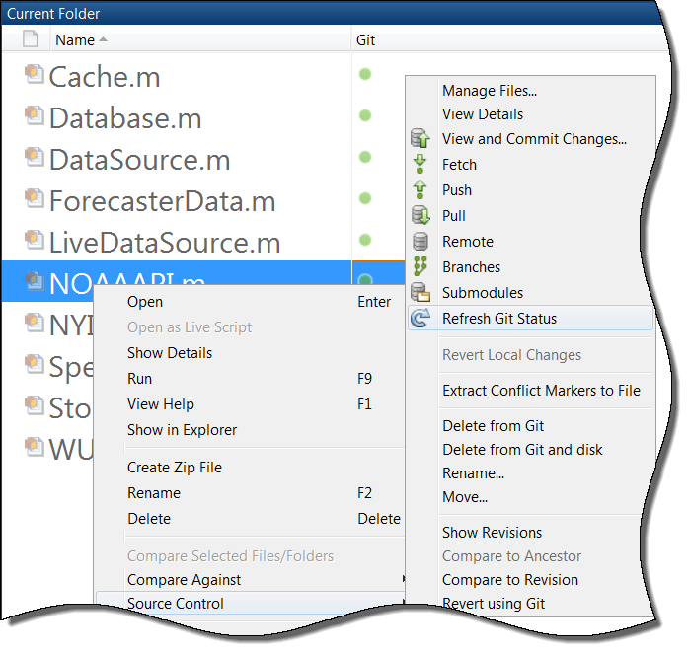
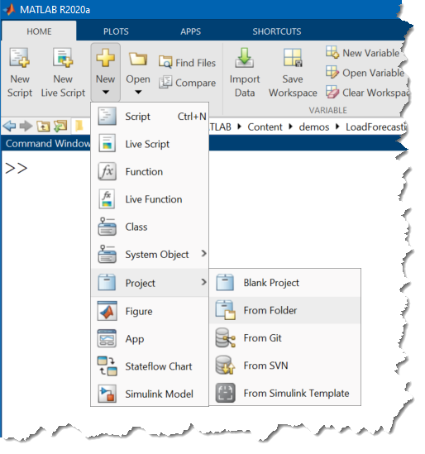
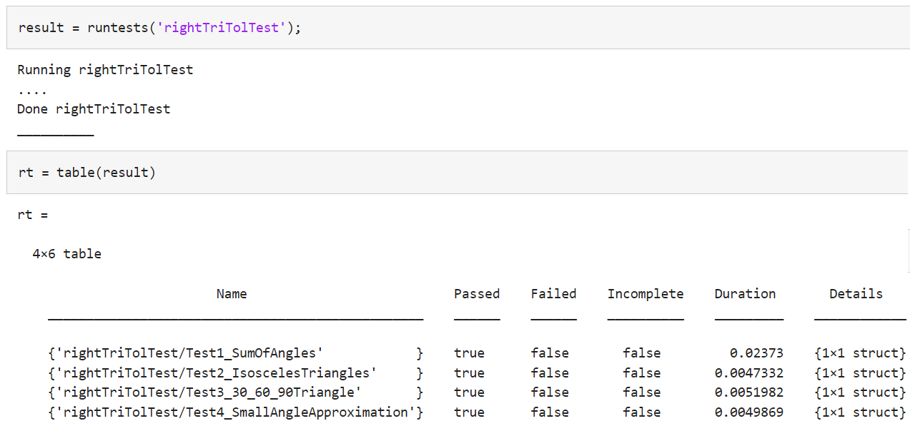
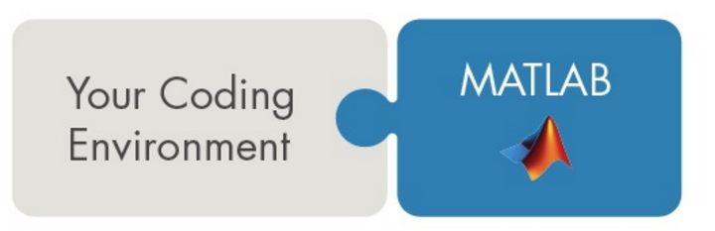
Grow from coding by yourself to coding in a team
Call Libraries Written in Another Language
Projects
Source control
Testing & CI
External interfaces
Call MATLAB from Another Language

Slide 15



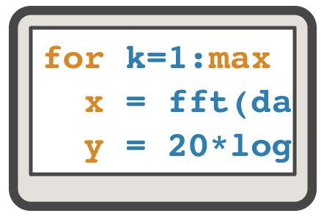


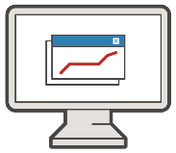
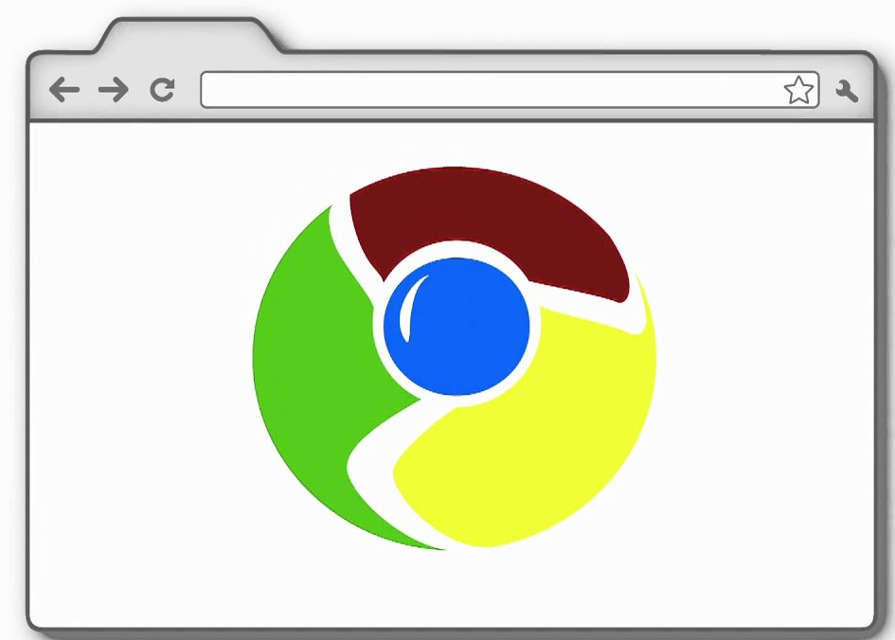

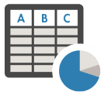


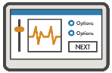
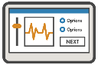

Deploy your applications to non-MATLAB users
Simulink Compiler
Simulink
Coder Products
MATLAB Compiler
MATLAB Compiler SDK
MATLAB
Embedded Hardware
Desktop and Web Deployment
Enterprise Systems
MATLAB
Web App
Docker
Container
Excel
Add-in
Hadoop/
Spark
C/C++ DLL
Java JAR
++
Python py
.NET DLL
MATLAB
Production
Server
C, C++
HDL
PLC
CUDA
.exe
Deployed Simulation
MATLAB Production Server
MATLAB Web App Server

Slide 16
Agenda
Low Code Data Analysis
Demo – Modeling Flight Sensor Data
Learning Resources

Slide 17


MATLAB Central Community
Every month, over 2 million MATLAB & Simulink users visit MATLAB Central to get questions answered, download code and improve programming skills.
Blogs
Answers
Blogs
MATLAB Answers: Q&A forum; most questions get answered in only 60 minutes
MATLAB Answers
File Exchange: Download code from a huge repository of free code including tens of thousands of open source community files
File Exchange
ThingSpeak
Cody: Sharpen programming skills while having fun
Blogs: Get the inside view from Engineers who build and support MATLAB & Simulink
Learn
Contribute
Connect
Cody
and more…
ThingSpeak: Explore IoT Data
And more for you to explore…

Slide 18


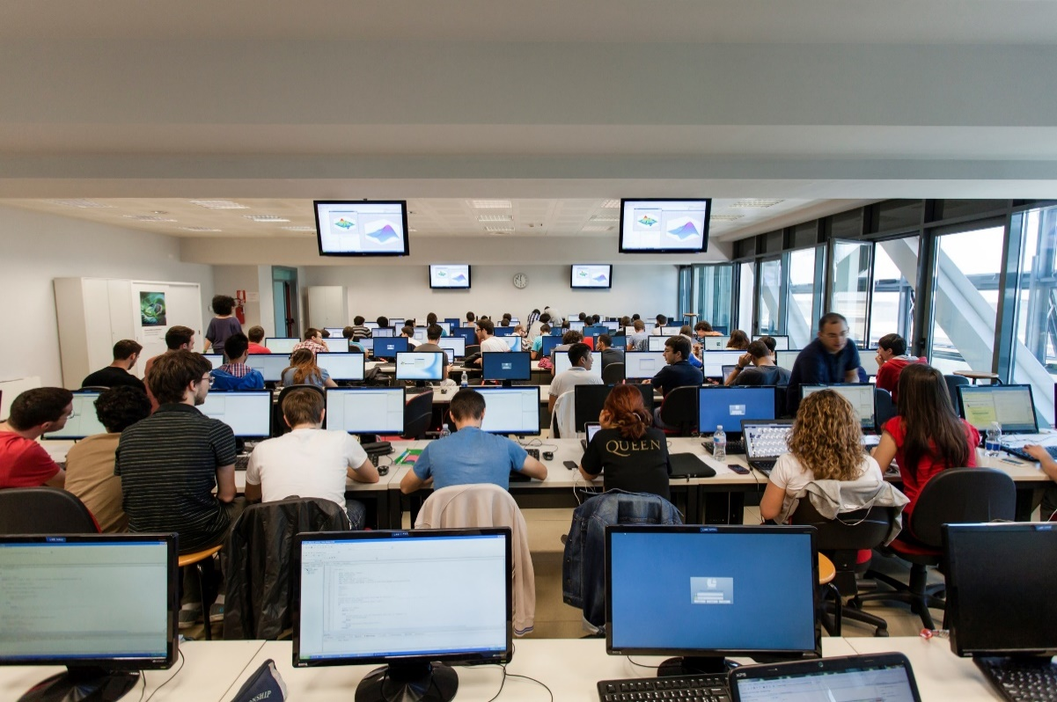


MathWorks Engineering Support
Training
Guided Evaluations
Onsite Workshops
Consulting
Technical Support
Notes:
MathWorks have engineers who:
Enable you to easily onboard new hires from different industries or new college graduates
Provide hands on sessions to demonstrate a variety of technical concepts
Work with you and your data to guide you through how deep learning could unlock value within your organization
Customize services based on your needs to optimize your investment and ensure your success.
Take your critical feedback so they can provide you with the fastest, most productive engineering platform available
Please let us know if you’re interested in engaging with us further on any of these options.

Slide 19
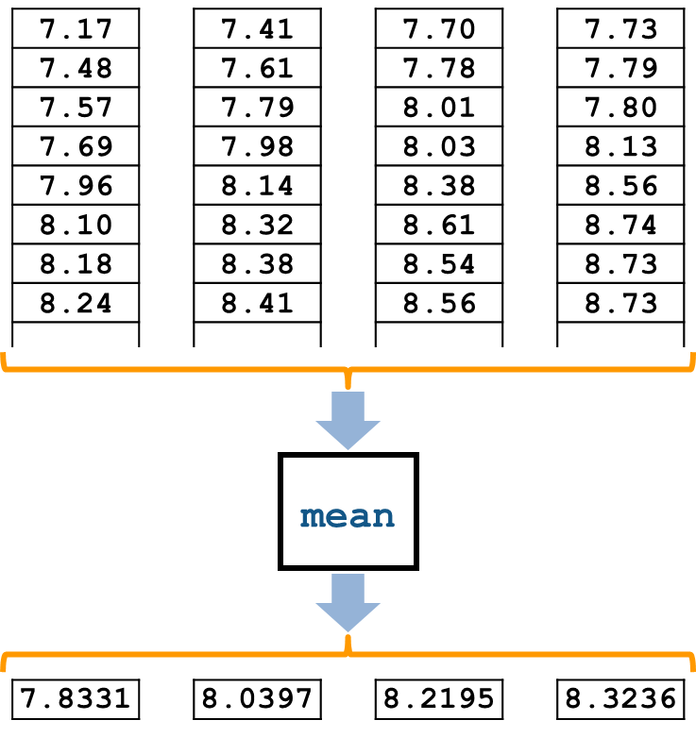
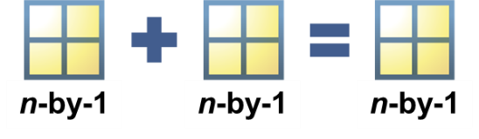
Training: MATLAB Fundamentals
After this 3-day course you will be able to:
Import, analyze, and export data
Write programs to automate complex tasks
Perform calculations and analysis on data sets
Create informative data visualizations
Notes:
Use: After any introductory MATLAB demo.
Target audience: all new users (including those who “used MATLAB 14 years ago in grad school”). Emphasis on Excel users; data analysts (but still very useful for programmers/algorithm developers/modellers). Useful for CDA people who need MATLAB basis, but is probably more than they need; commonly trimmed and combined with Simulink to make a custom onsite training.
What is in: Basics of MATLAB environment and language. Scripts & functions. Logic. Basic data analysis workflow (import, preprocess, compute & visualize).
What is not: sophisticated import (textscan), customized graphics [see MATLAB for Data Processing and Visualization]; serious programming stuff [see MATLAB Programming Techniques]; any applications with other toolboxes [see a bunch of other courses]; application building [see Building Interactive Applications with MATLAB for interface stuff and basic standalone deployment], deployment, code gen, or interfacing with other languages [see a bunch of other courses].
Prerequisites/level: Beginner level. No prereqs.
Course details: 3 days. Public or onsite. In person, online live, online self-paced.
Note: There are also automotive- and aerospace-specific variants. (Same concepts but different exercises [don’t need to reveal that to customers]) Can use this to persuade the obstinate.

Slide 20
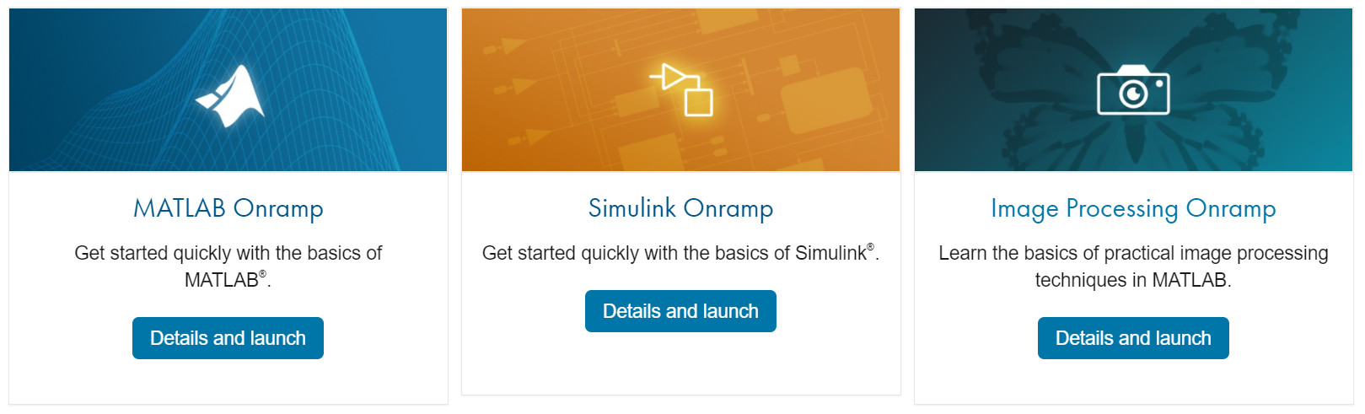
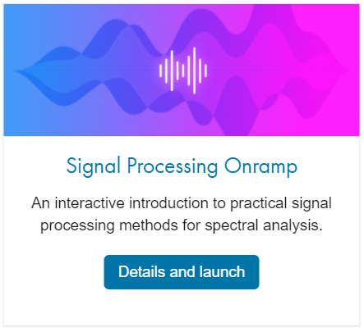
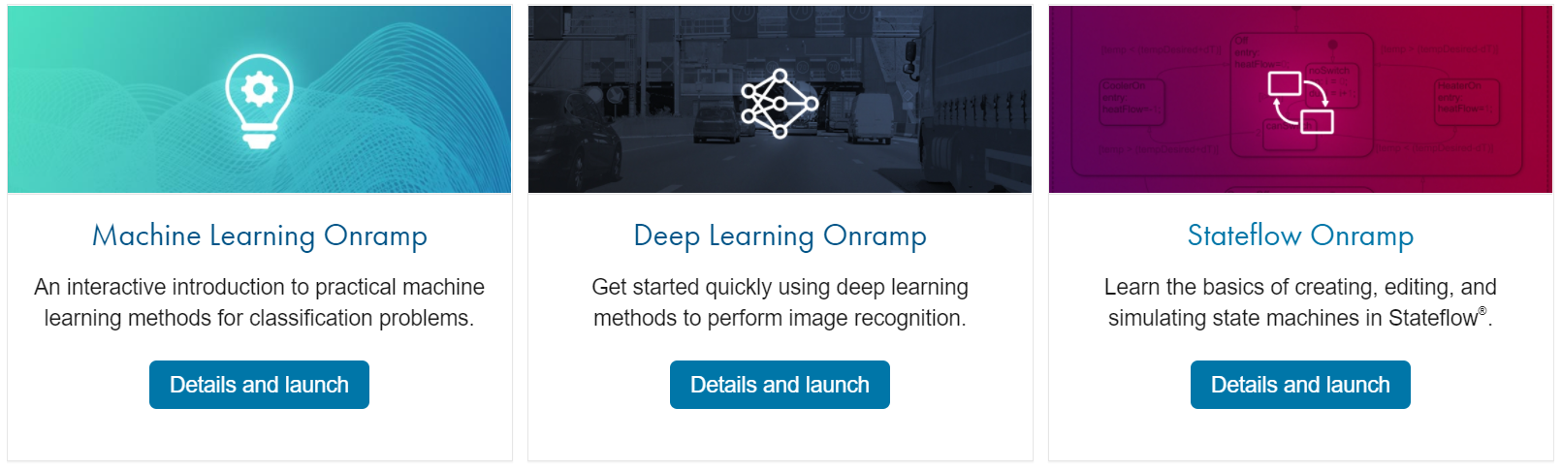
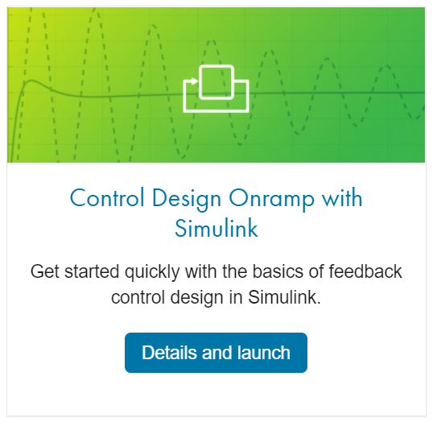
Get Started for Free with Onramp Courses
https://matlabacademy.mathworks.com/

Slide 21

Feedback
https://share.hsforms.com/1sLjuHVP4Tk-SvxXGkiC-4g3sou6

